Slide 1

ANIMAL HAVEN
Presented by:
Prachi Agarwal(191500552),Sec-C
Ritika Brewal(191500663),Sec-D
Neha(191500489),Sec-D
Priya(191500599),Sec-A

Slide 2

OUTLINE
About the project
Objective
Requirements
Snapshots from the website

Slide 3
ABOUT THE PROJECT
Our Fullstack Project “Animal Haven” is an online website that
will provide its user, the information regrading all the veterinary
hospitals and the rescue centers in Mathura.
It contains the contact numbers, addresses, maps of the hospitals.

Slide 4
OBJECTIVE
STRAY ANIMAL SAFETY : The website mainly aims on the safety of the stray animals that are not looked after by anybody and sometimes many people those who want to help the injured and sick animals lying on the roads are not aware of the veterinary hospitals in the particular area. So, our website will help them find the nearby hospital.
USER FRIENDLINESS : The website will be very easy to use enabling even a novice person to use it.

Slide 5
REQUIREMENTS
Software Specification Used :-
Technology Implemented: Fullstack Web Development
Languages/Technologies Used: HTML5, CSS3, JavaScript, Bootstrap
IDE Used: Visual Studio Code
Web Browser: Google Chrome

Slide 6
Hardware Used :-
Processor Used: Intel i5
Operating System: Windows 10
RAM: 4 GB (minimum)
Hardware Devices: Computer System
Hard Disk: 256 GB

Slide 7
GLIMPSE TO OUR
WEBSITE
Hope you like it :)

Slide 8
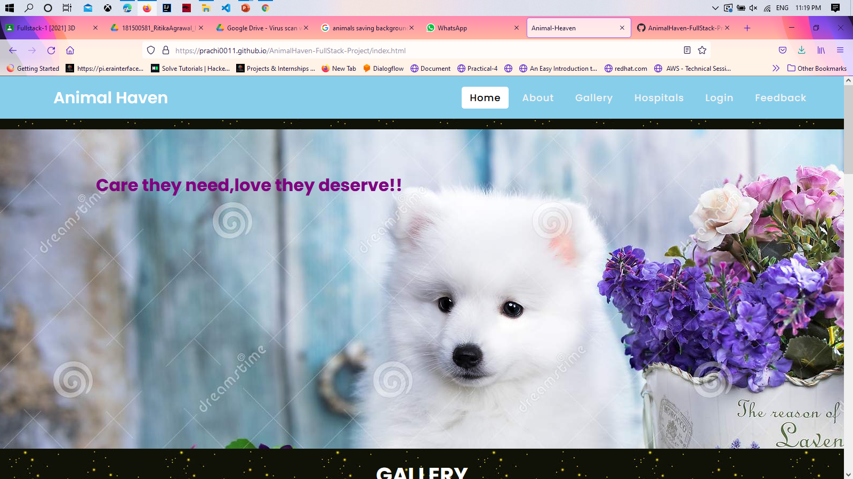
HOMEPAGE

Slide 9
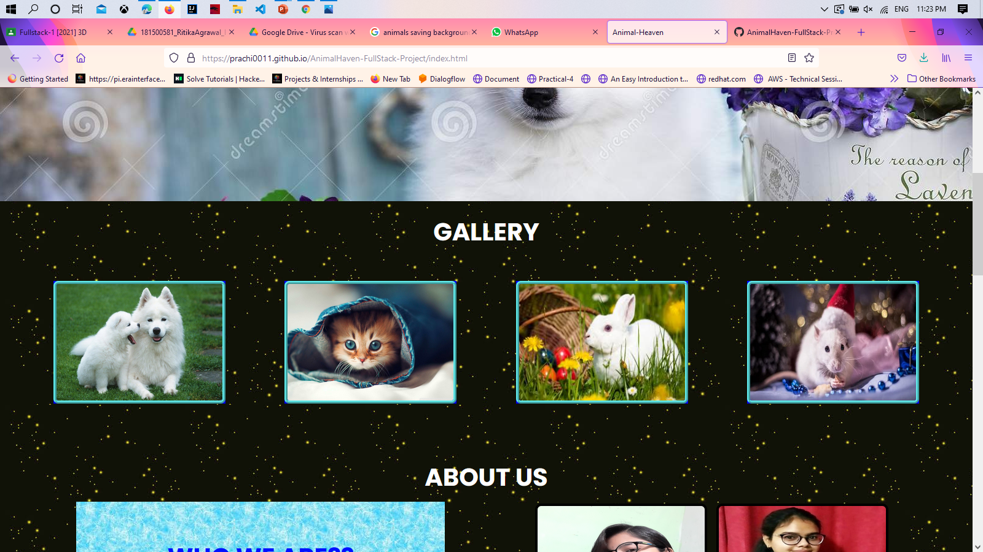

Slide 10
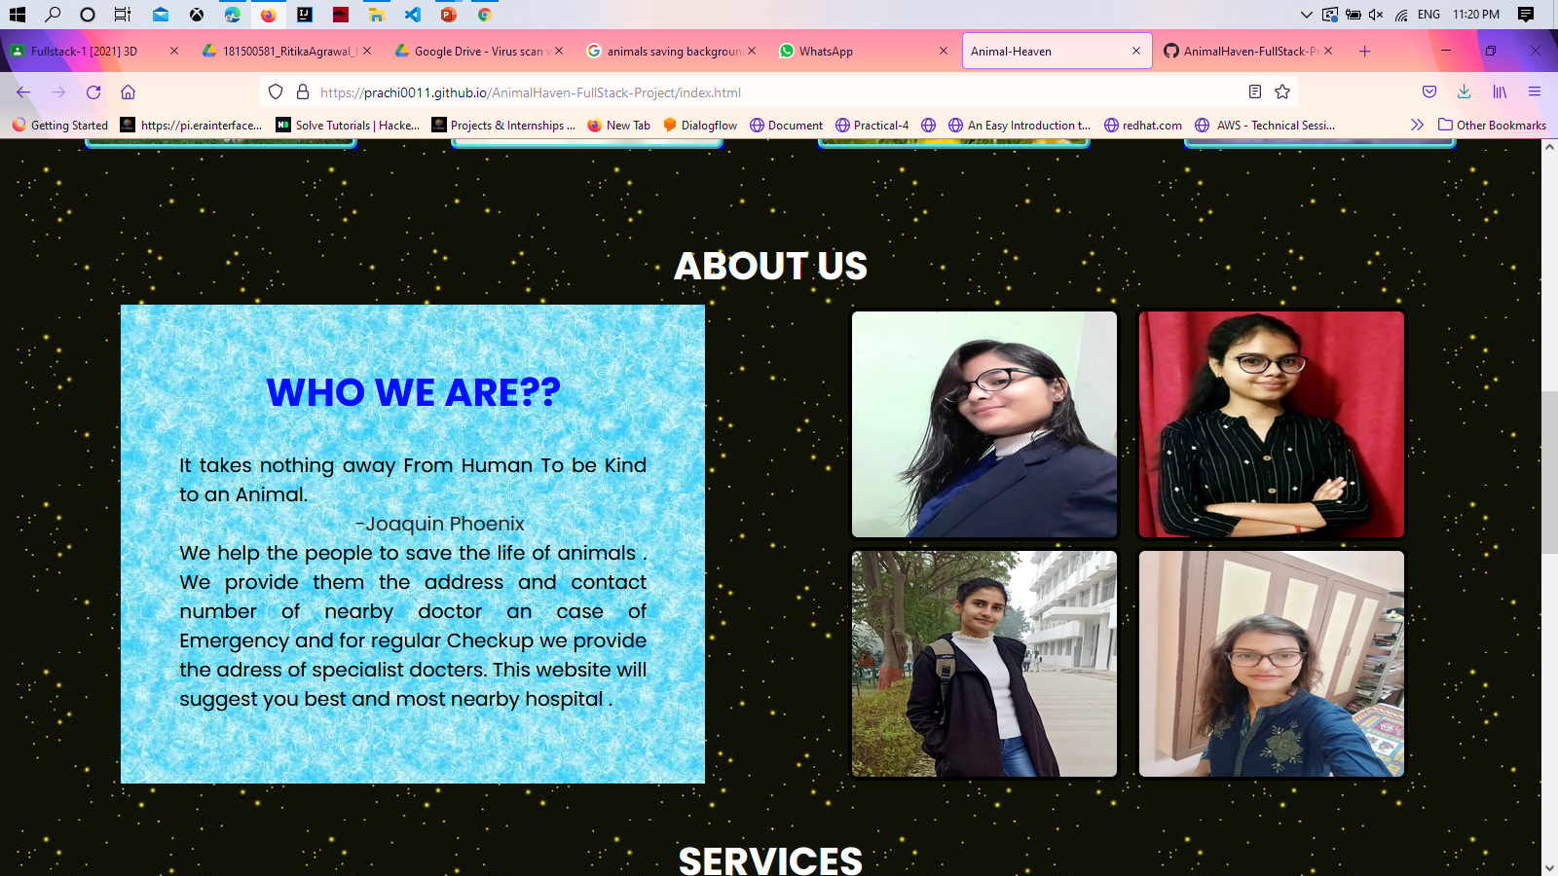

Slide 11
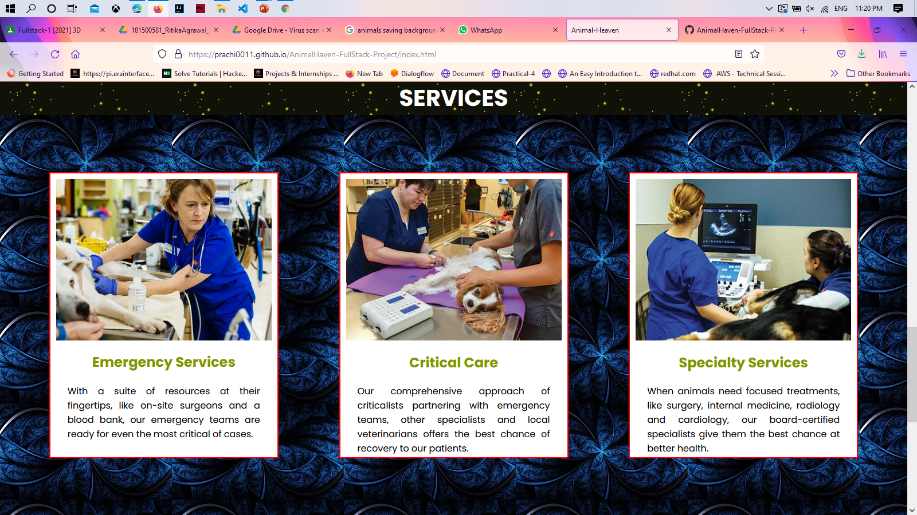

Slide 12
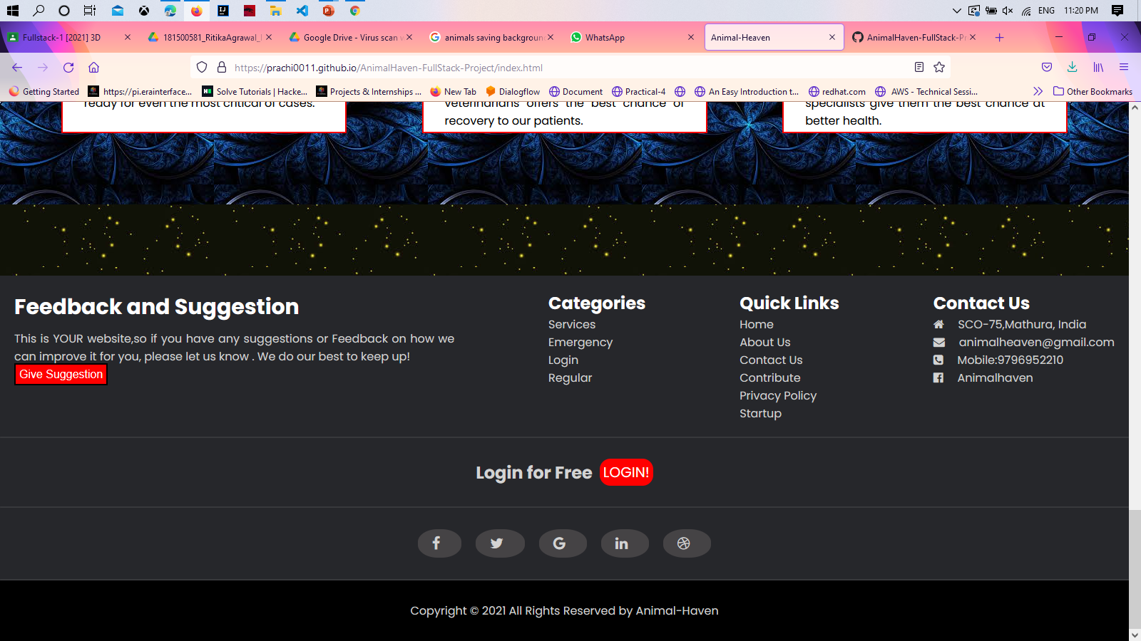

Slide 13
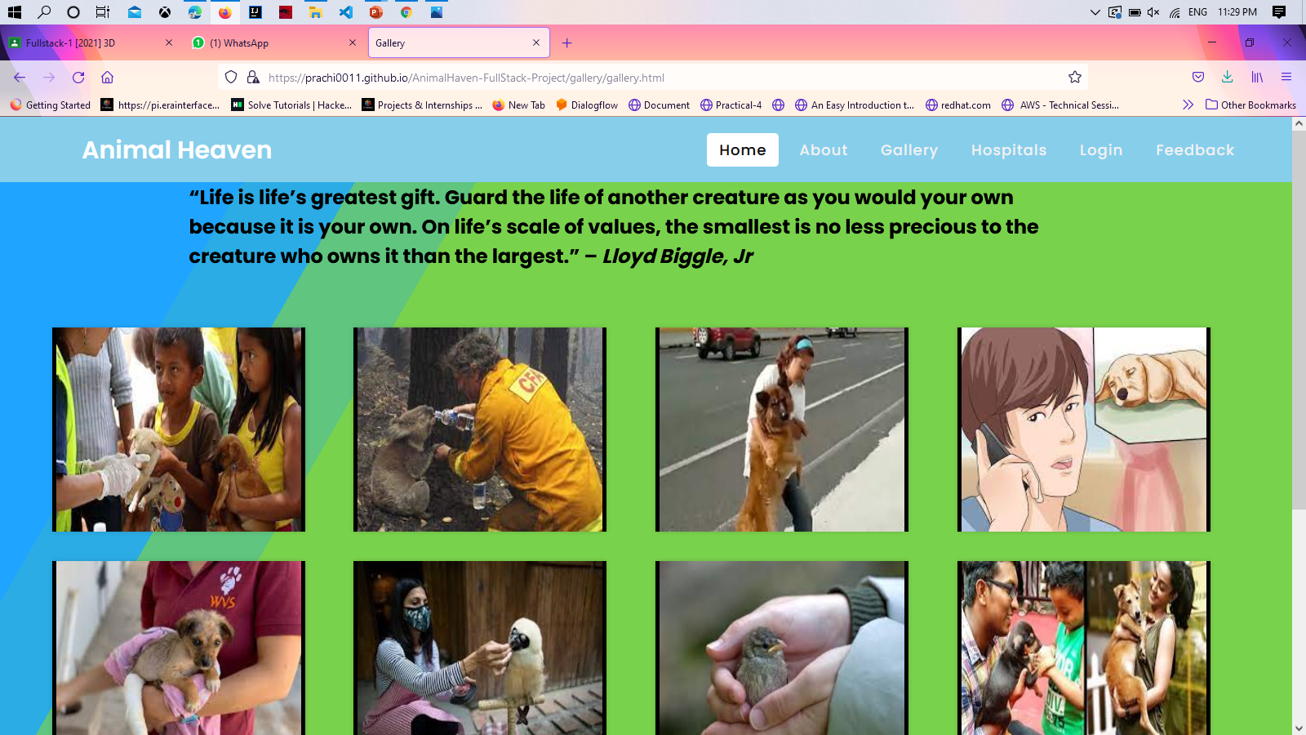
2. GALLERY

Slide 14
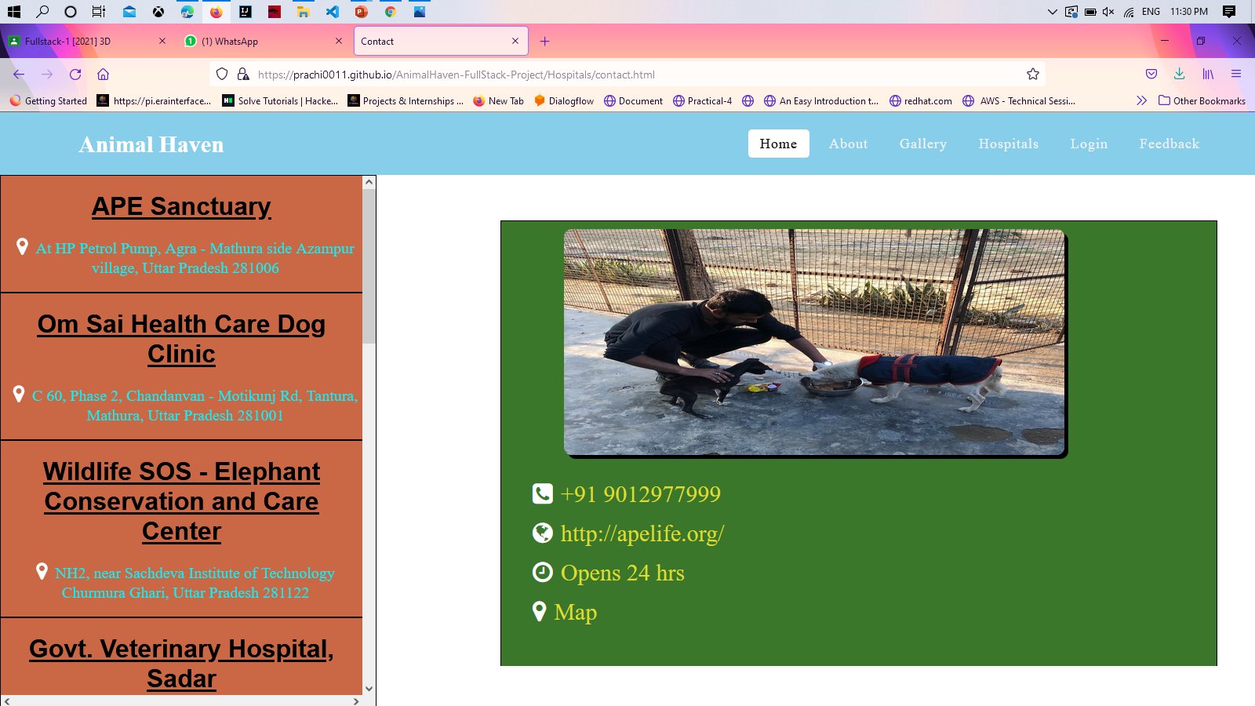
3. HOSPITALS

Slide 15
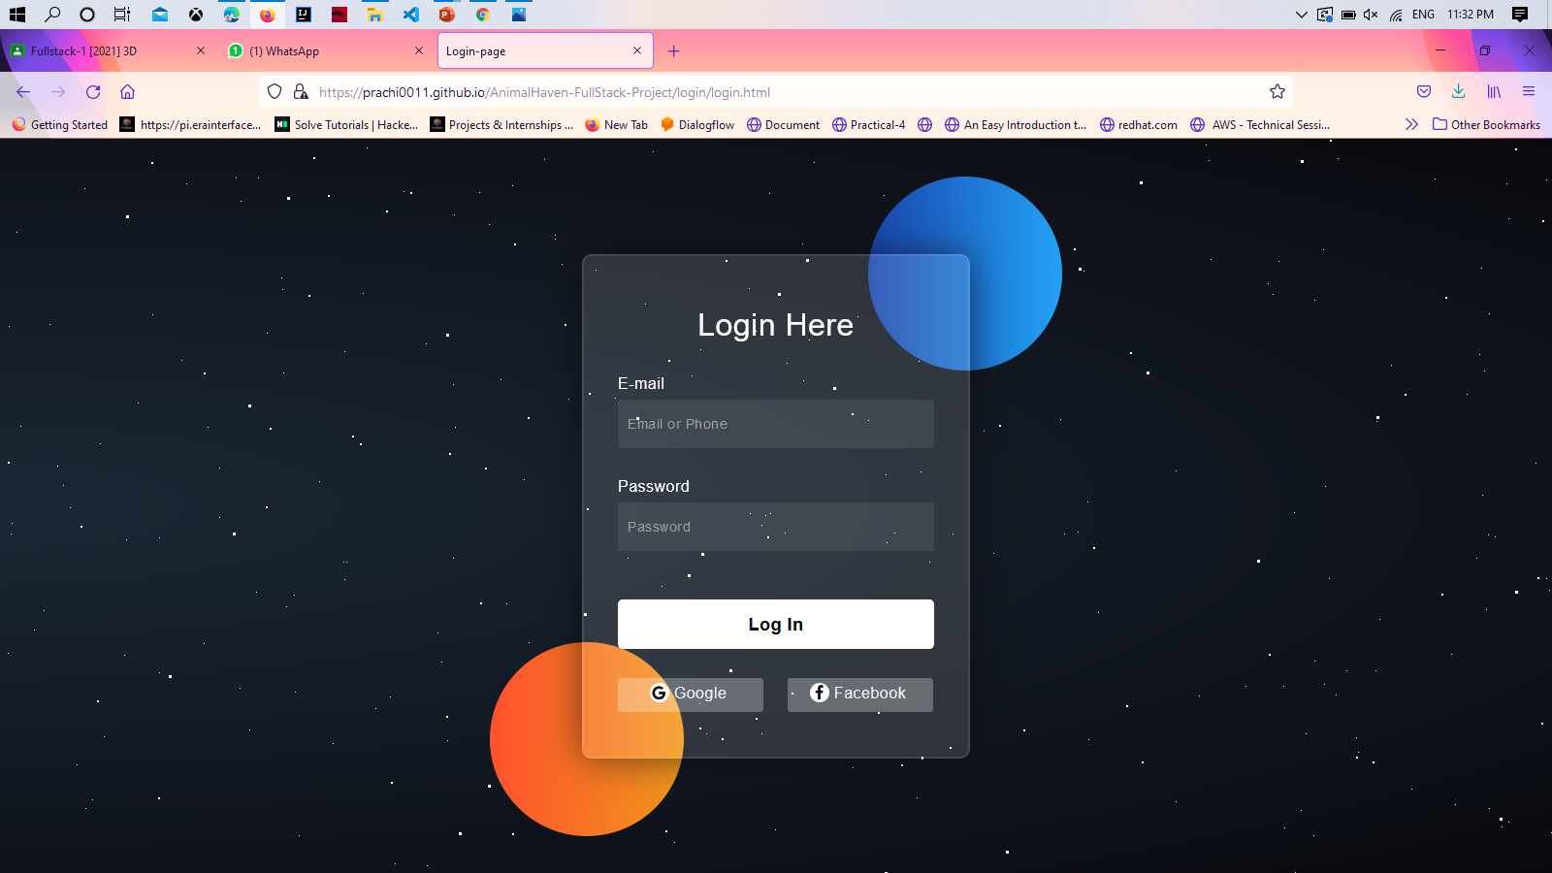
4. LOGIN PAGE

Slide 16
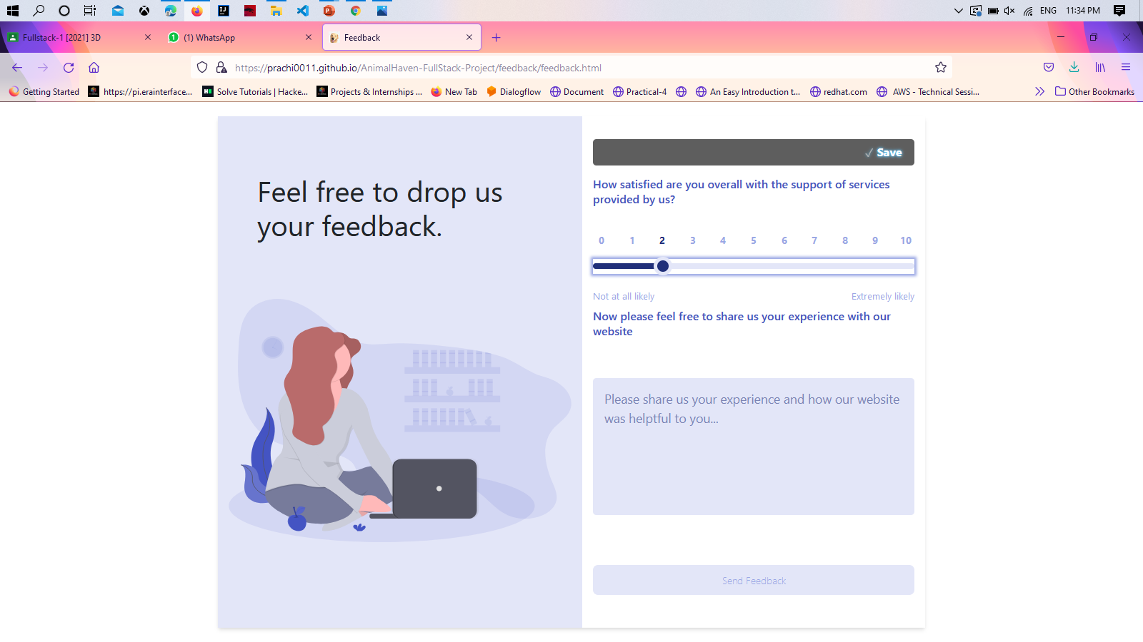
5. FEEDBACK PAGE

Slide 17
THANK YOU

